Slide 1
1. Theme
View Product List
Select Template
Customization
2. Product
View Themes
Preview & Quantity
Additional Related Products
Pay
HOME PAGE
Upload Own Design
3. Special Categories

Slide 2
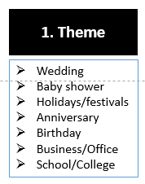
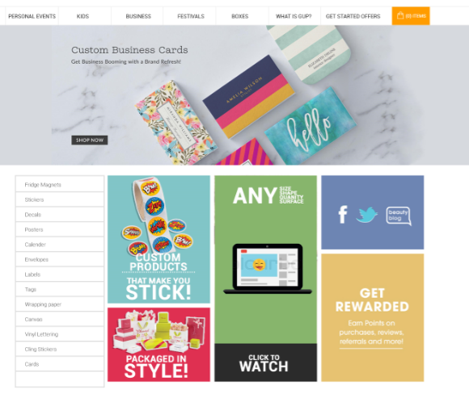
1.) SELECT THEME
Select any Theme

Slide 3
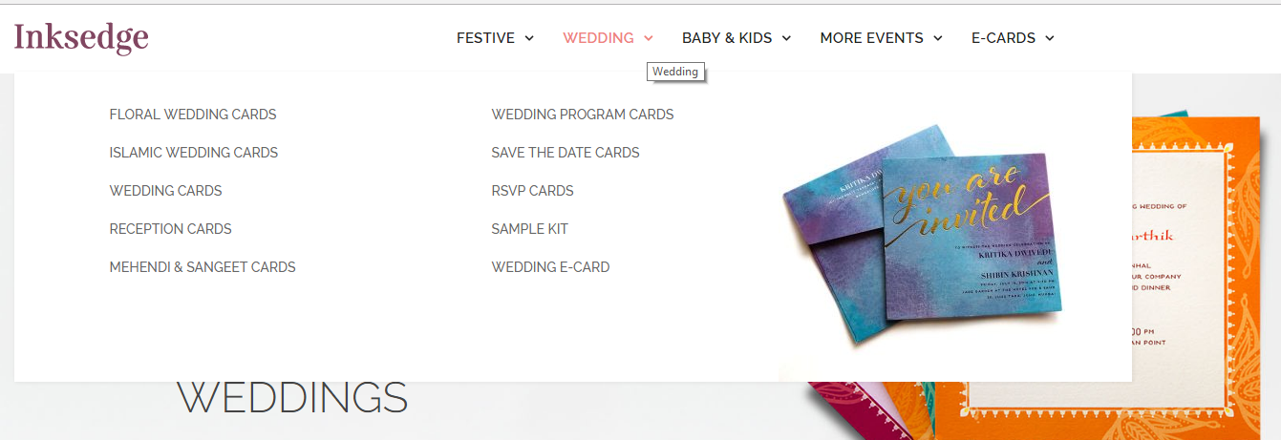
1.) SELECT THEME
Select any Theme

Slide 4
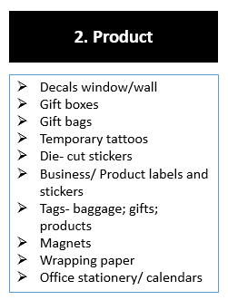
2.) SELECT P RODUCT
Select any Product

Slide 5
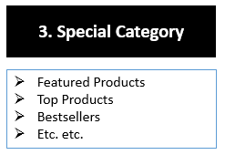
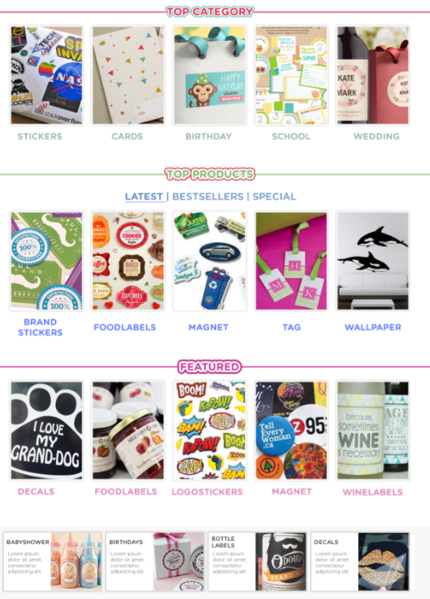
3.) SELECT SPECIAL CATEGORY
Select any Special Category

Slide 6
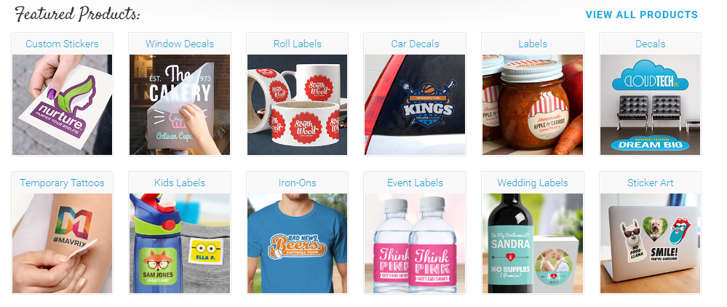
VIEW PRODUCT/THEME OPTIONS
Select desired product/theme

Slide 7
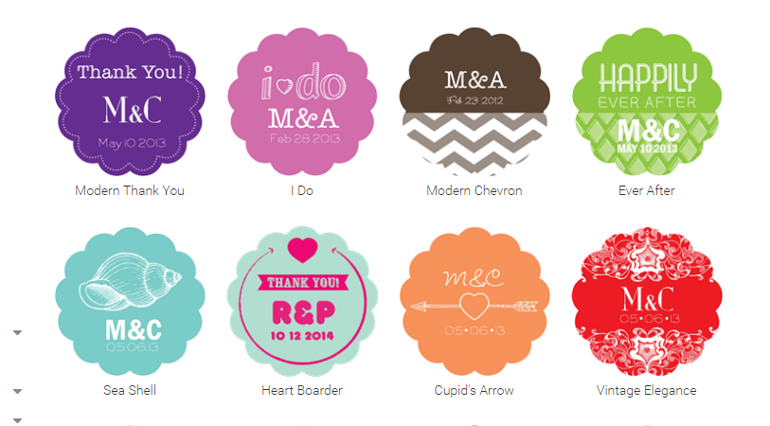
SELECT PRODUCT TEMPLATE
Select desired template

Slide 8
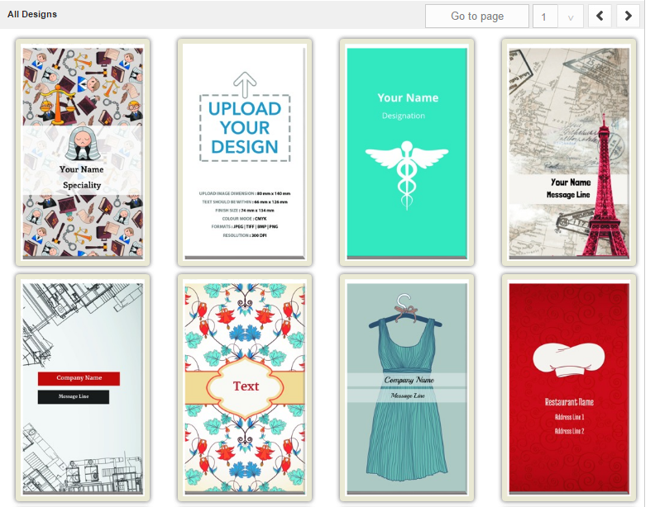
UPLOAD YOUR OWN DESIGN
Upload your own design

Slide 9
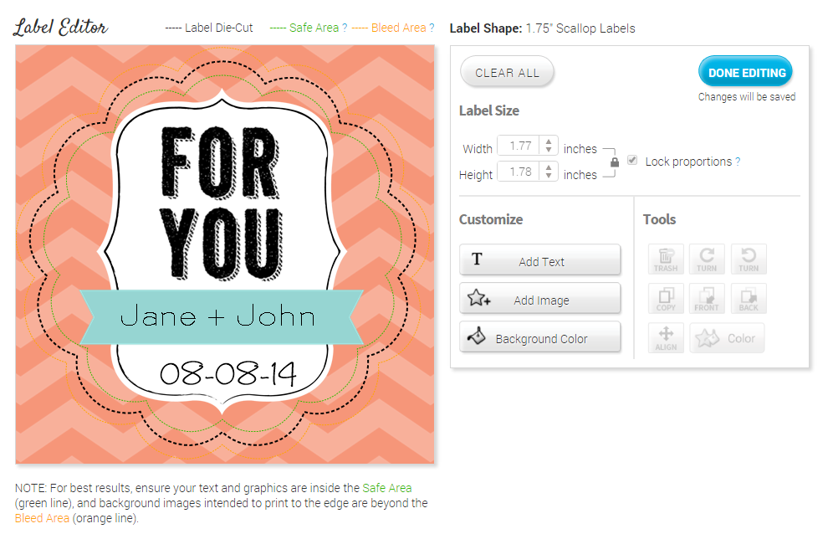
CUSTOMIZATION
Label size option ??? Should we give??
I think template should be fixed..
Or we can have two options to choose from
1. Big; 2. Small
http://www.stickeryou.com/2/stickermaker/create/2/3/template/1312171723007898845#details

Slide 10
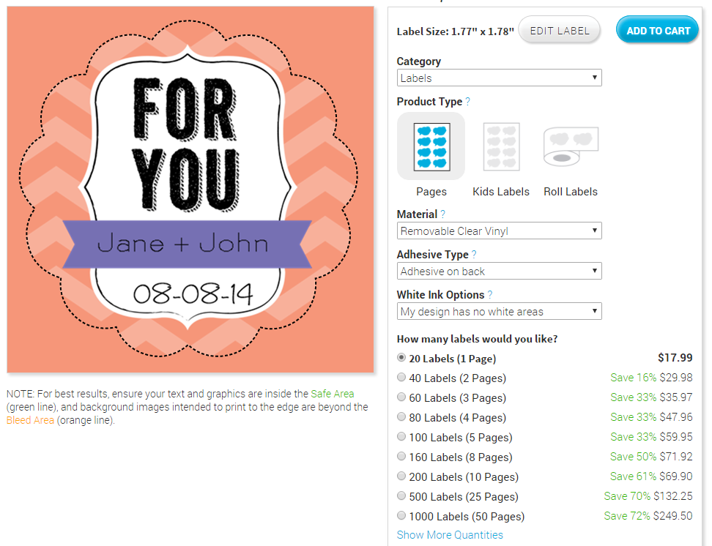
PREVIEW AND QUANTITY
http://www.cafepress.com/mf/106105620/nein_sticker?productId=1885309925

Slide 11
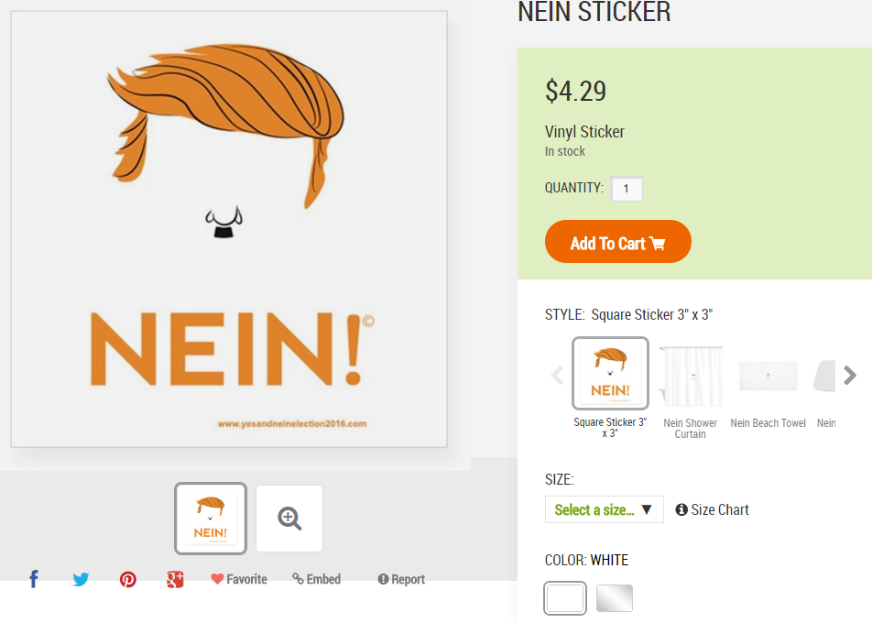
http://www.cafepress.com/mf/106105620/nein_sticker?productId=1885309925
Good way to show white vs. clear option in vinyl stickers

